Slide 1
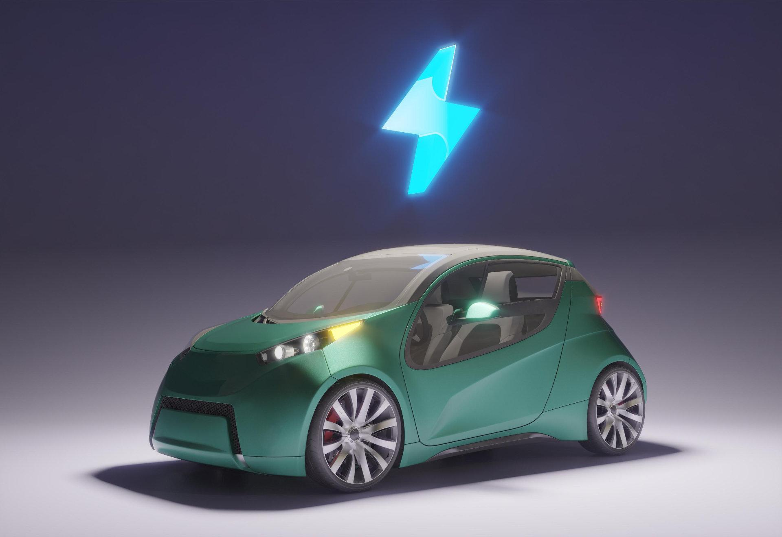
Auto Industry- Conversion from Conventional Vehicles to Electric Vehicles
Group Members
Divyang Hirpara
Aayushi Patel
Ayush Patel
Vrushabh Shah
Tanay Trivedi
Sohail Arif

Slide 2
Research Question 1
Model-
Conventional Cars Electric Cars = Carbon Emission

Slide 3

Effects Of Carbon Emission on Environment
Contribute towards Air polution
Vehicle pollutants harm our health and contain greenhouse gases that cause climate change.
Carbon emission caused by vehicles is one of the major cause of global warming which caused harm to human health , food production , increase in duration and intensity of storms etc.
Image of Landslide in Italy caused due to Climate Change.

Slide 4
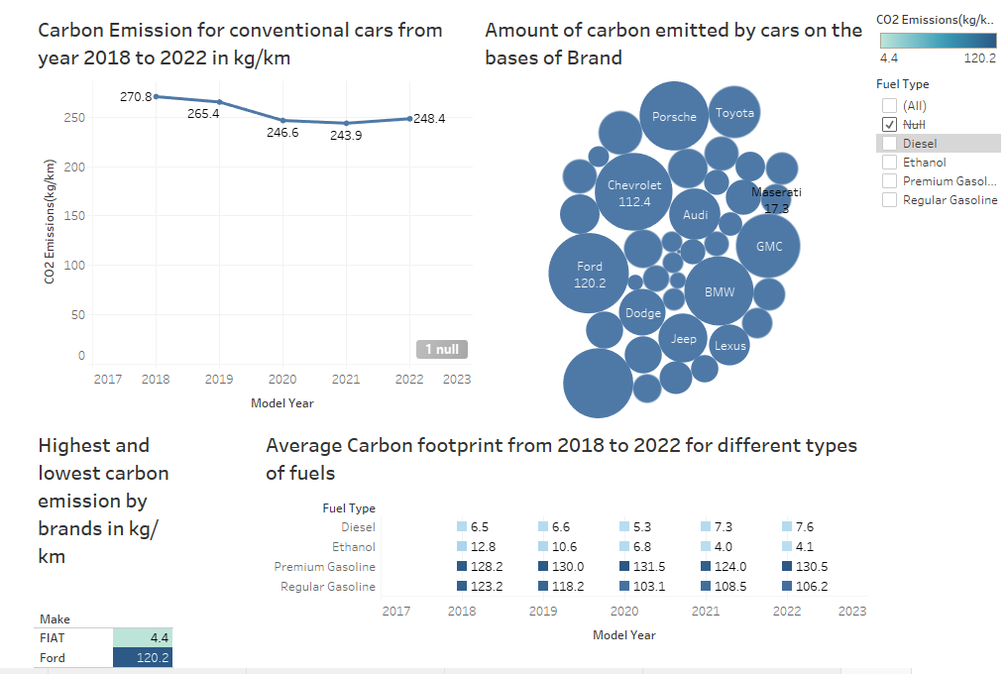
DATA OUTPUT ON CARBON EMISSION BY CONVENTIONAL CARS

Slide 5
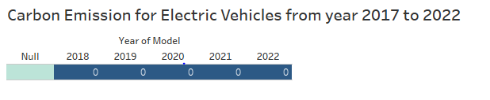
Data Output on Carbon Emission by Electric Vehicles

Slide 6
INTERPRETATION
Average carbon emission to by conventional cars to from 2018 to 2022 is 255 kg/km
Electric Vehicles
Carbon Emission by Electric vehicles is Zero
Average Carbon emission according to fuel type
Conclusion
Looking at the outcomes we can conclude that carbon emission from electric vehicles is almost zero and has very less baring on the environment.
Diesel- 6.66 kg
Ethanol- 7.66 kg
Premium Gasoline- 128.84 kg
Regular Gasoline-111.86 kg

Slide 7
Research Question 2
Model-
Non –Electric Vehicles VS Electric vehicles
Vehicle Price
Maintainance cost
Crude oil price

Slide 8
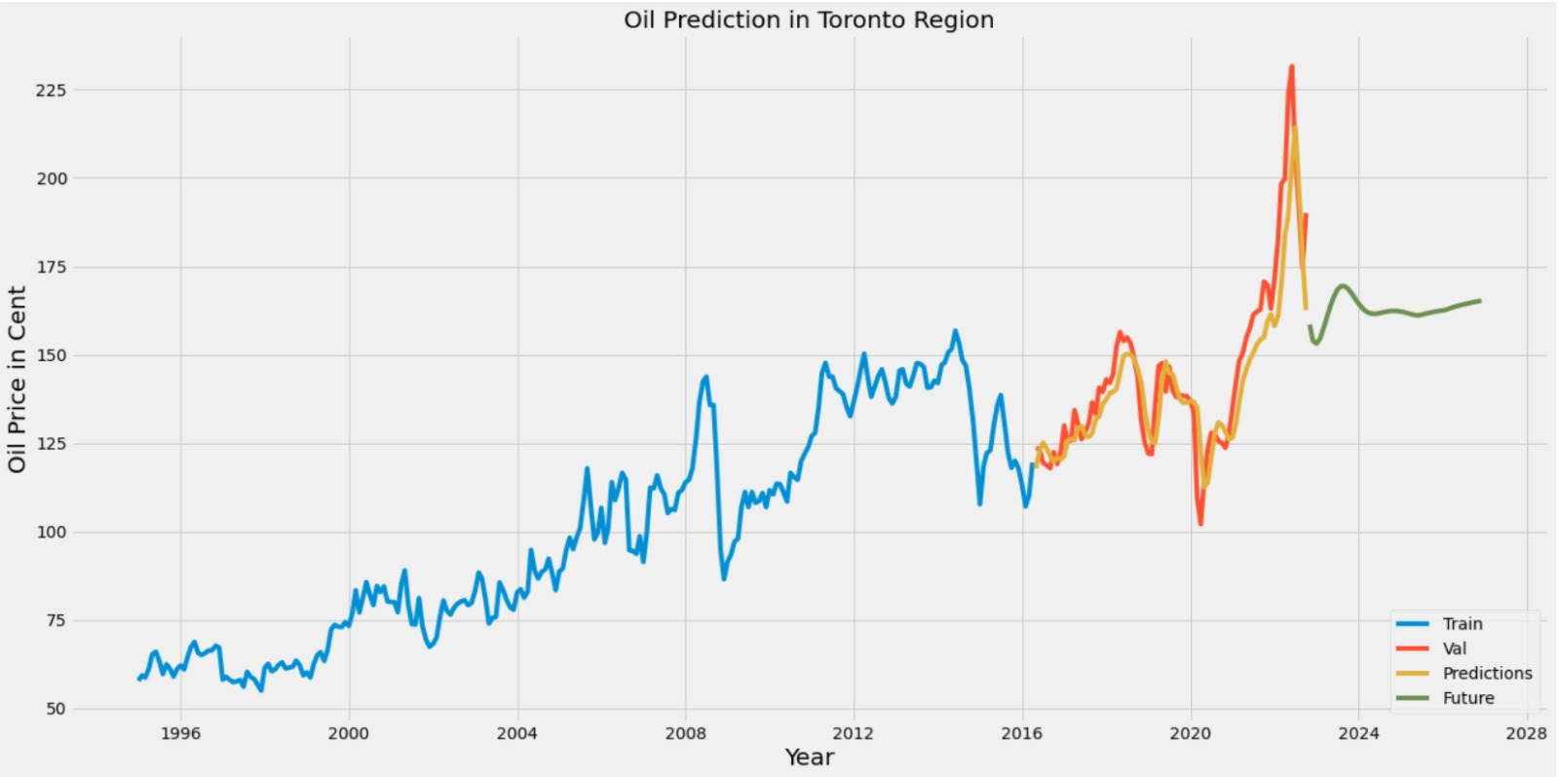
DATA OUTPUT ON Oil Price Prediction specific for Toronto Region
Model: LSTM(python)

Slide 9
INTERPRETATION
01
02
NON ELECTRIC VEHICLES
ELECTRIC VEHICLES
Short Run-
Price-Costing of non EVs is comparatively less at the initial stage as compared to EVs which is around $48000.
Long Run-
Maintenance- maintenance of non EVs is more in the long run and costs more. (1400$ - 1500$ per year).
Crude oil- Also prices of crude oil are going to increase in near future as they are limited natural resources.
Short Run-
Price-Costing of EVs is comparatively more at the initial stage as compared to non Evs which is around $54000.
Long Run-
Maintenance- EVs comparatively give less maintenance as compared to non EVs in the long run.
Crude oil- There is no need of crude oil when it comes to EVs as they need to be charged to run.

Slide 10

Discussion and Recommendation
From the data outcomes we can clearly see that electric vehicles have an edge over conventional vehicles as it has zero carbon emission.
We can conclude that electric vehicles has less effect on environment as compared to conventional vehicles.

Slide 11
Decisions and Recommendations
EVs cause less harm to the environment and has barely any carbon emission which one of the major reasons of why there should be shift from conventional cars to EVs
From the outcomes of research Question 2 we can say that though initial costing of EVs more but has an edge over conventional cars in long run.
Also prices of crude oil are going to increase day-by-day and are eventually going to cost more to the people as compared to Evs in the near future.

Slide 12
Thank You

